Slide 1
D&D Encounter Balancer Team TPK
Brandon Thompson - thomp2b2@mail.uc.edu Nick North - krousenj@mail.uc.edu Sam Puffer – puffersd@mail.uc.edu Advisor John Gallagher - gallagj9@ucmail.uc.edu

Slide 2
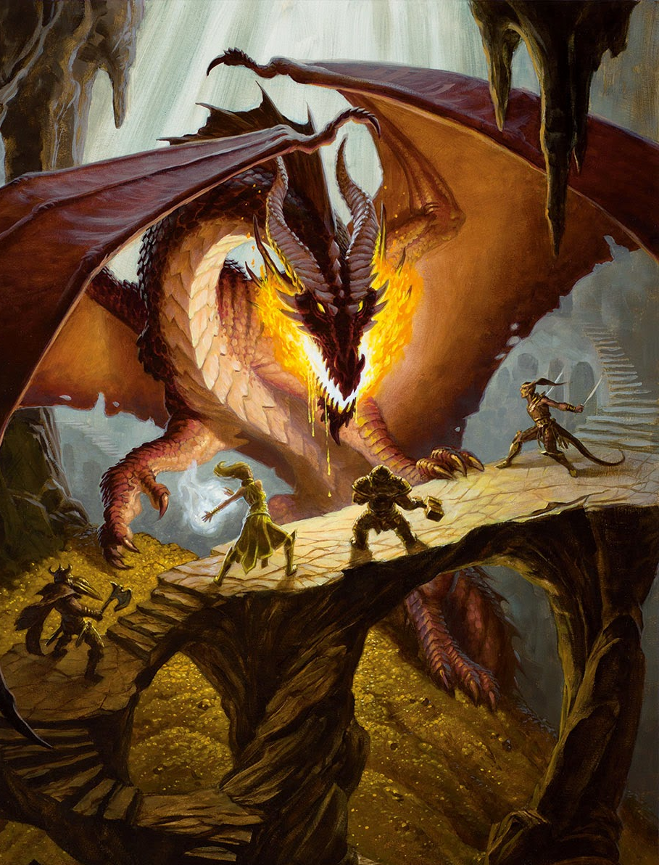
Project Abstract
The goal of this project is to obtain valuable information for Game Masters in D&D games. The central question is how much information can we provided people based off player and monster stats using a Monte Carlo Simulation. This approach presents some complicated issues, but with some generalization the work becomes clearer. The information that we are gathering for people will help them plan the difficulty of encounters before running them. The end result will be a form of statistics regarding the success rate and casualties for the GM’s players.

Slide 3
User Stories
As a person who runs a Dungeons and Dragons group, I want to see more information about combat encounters. This will help me plan my sessions easier and run my combats more smoothly.
As an adventure designer for commercial published material, I want to make sure the encounters I create are properly balanced and play-tested to be at the set level the adventurers are.
As a dungeon master, I want to be able to tweak existing monster stat blocks to make the fights more challenging, but also be able to know they aren't too stacked against the party's favor.
As a D&D player, I want to engage in fun combat encounters, and I wish there was a tool for my DM to make our current sessions more exciting.
As a concerned parent, my child spends too much time designing complex dungeons and dragons encounters, I wish there was a tool to simplify the process, so that they can get their life back.

Slide 4
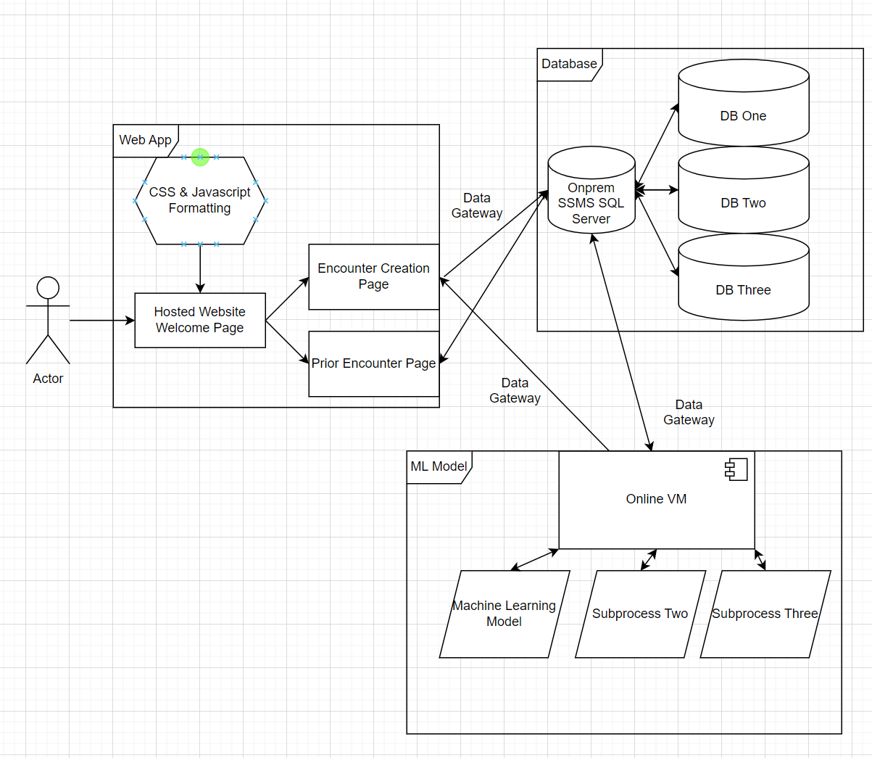
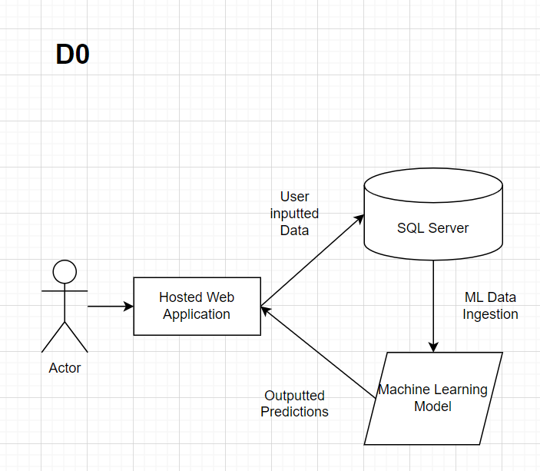
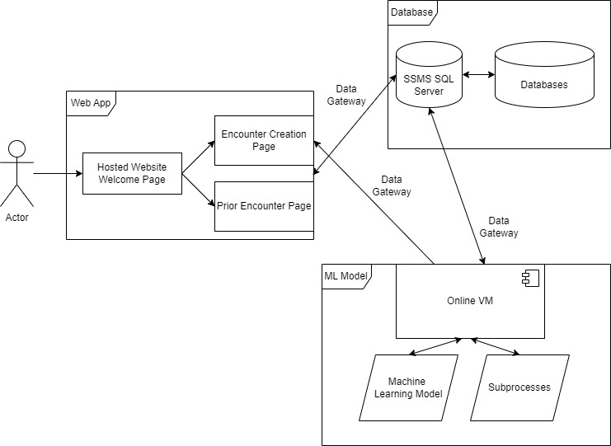
Design Diagrams
D2
D0
D1

Slide 5
Major Project Constraints
We’ll face some economic limitations. Our final project is a website, so there will be costs for the web domain and site address. There will also be server costs for the database we'll be implementing. We may also need to pay for software to properly develop our product.
Because our project is intrinsically tied to the Dungeons & Dragons brand, there could be some legal repercussions from Wizards of the Coast and Hasbro, the developers and owners of the IP. However, we don't foresee this happening. D&D has a deep history of open-use, "homebrewed" content for both game materials and software. Because of this past precent as well as the scope of our project, we don't believe we'll face any legal repercussions with the IP holders.
Lastly, we may face some diversity and cultural limitations. We are designing our software with only English-speakers in mind. This is because none of us speak another language. This risks alienating non-English-speaking users

Slide 6
Project Progress Review
As of this recording, we are working out the exact specifications of our input and output with our Monte Carlo Simulation.
Regarding the front-end aspect, 10x10 sketches are being drawn up for the first draft, with user interviews on the sketched layouts set to come within the next week or two.

Slide 7
Division of Work
Nick
Specify our actors’ options in a simple format
Design web application
Design web home page
Design new encounter
Design past encounters
Test web application
Brandon
Research possible monster actions
Gather info on actions common to DMs
Create new monsters based of initial design
Create our Monte Carlo simulation
Document the simulations performance
Refine the simulation after testing
Sam
Research possible player actions
Gather info on actions common to players
Create new actors based off initial design
Refine our data to keep it readable
Implement our data into our actors

Slide 8
Expected End of Semester Accomplishments
By the end of this semester, we plan on having a running simulation, most likely needing heavy tweaking still
The hope for the website is to have the base functionality of the site up and running, without the edits for making it look appealing and easy to use waiting till next semester. It should be hooked up to the database and simulation at that point as well.

Slide 9
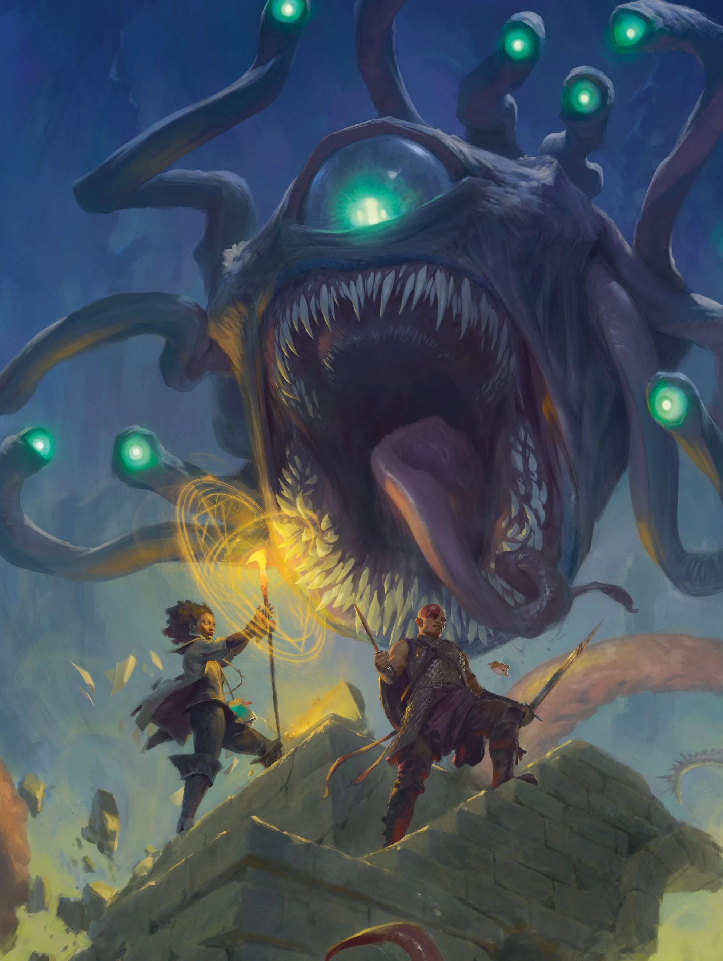
Expected Demo
The expected demo of this project will include a website that people can access, then input some information about their players and monsters. This will then translate to a Monte Carlo Simulation that we have set up with the variables inputted that will lead to results on the website. We also plan on letting people save their encounters and look back on them.

